Slide 1
Black Jack

Slide 2
Black Jack
What is Black Jack?
Gambling card-game against the Croupier (dealer)
Goal:
Get closer to 21 points than the Croupier without exceeding that score
Usually played with six standard 52-card decks (312 cards)

Slide 3
Black Jack
Cardvalues
2 – 9 : The value shown on the card
Kings, queens and jacks : 10 points
Ace : Either 1 or 11 points (freely decidable)

Slide 4
Cardvalues
2 – 9 : The value shown on the card
Kings, queens and jacks : 10 points
Ace : Either 1 or 11 points (freely decidable)
Moves
Hit
Stand
Double / Double Down
Split
Surrender
Bust / Break

Slide 5
Strategies
General
Soft 17
Card Counting
Strategy Table

Slide 6
Strategies : General
Never over 21
Dealer >= 7 & Spieler < 16 -> HIT
Dealer <= 6 & Spieler <= 11 -> HIT
Dealer >= 7 & Spieler >= 17 -> STAND
Dealer <=6 & Spieler >= 12

Slide 7
Strategies : Soft 17
Ass + 6 -> STAND
Hand >= 17 STAND
Hit Soft -> Ass +6 HIT

Slide 8
Strategies : Card Counting
High Low:
Introduces in 1963 by Harvey Dubner
5 Steps

Slide 9
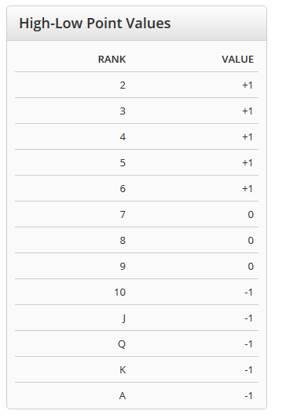
Strategies : Card Counting
Step 1:
Assign a point value to each rank

Slide 10
Strategies : Card Counting
Step 2:
Start with „Running Count“ of Zero
Keep adding or subtracting from the Running Count
Example:
3,5,K,7,Q,A,8,5,4,2 -> 1+1-1+0-1-1+0+1+1+1 = +2

Slide 11
Strategies : Card Counting
Step 3:
Divide the „Running Count“ by the number of decks remaining
-> „True Count“
Example:
Running Count = 7
4 Decks left -> 7 /4 = 1.75 ~ 2

Slide 12
Strategies : Card Counting
Step 4:
The greater the „True Count“, the more to bet
When and how much you bet depends on your own style
Try to make your play look natural ->
Increase bets after win
Decrease after a loss
Stay the same after push

Slide 13
Strategies : Card Counting
Step 5 (for some hands):
Play according to the „True Count“ AND a table of „Index Numbers“
The greater the count, the more inclined you will be to STAND, DOUBLE, SPLIT and SURRENDER
Example:
P: 15 , D: 10, True Count: 4 -> STAND if True Count >= 4

Slide 14
Strategies : Table
First time 1958
Left column hand of Player
Horizontal column hand of Dealer

Slide 15
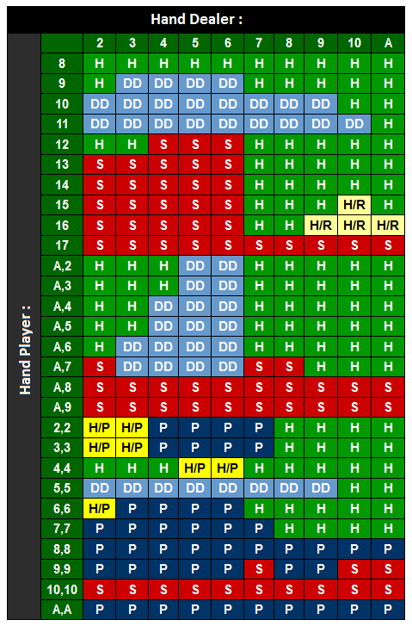
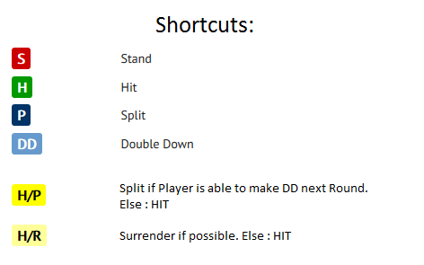

Slide 16
AI Relevance
Different types of agents
Simple Reflex Agent
Omniscient Agent
Model Based Reflex Agent
Goal Based Agent
Learning Agent
Predicate Logic
Java has a class for this with and, or and negate methods

Slide 17
Agents Performance
Name | Type | Wins | Loses | Blackjacks | Purse
WallHackAgent | Omniscient | 5587 | 3075 | 397 | 2262
AlwaysStandAgent | Simple | 3872 | 5618 | 466 | -1513
HitUntilAgent | Goal | 3987 | 5105 | 468 | -884
ReflexAgent | Simple | 3115 | 6811 | 463 | -4619
BasicStrategyAgent | Model | 4711 | 4746 | 489 | -527
HighLowAgent | Model | 4091 | 5328 | 434 | -6740
PredicateAgent | Model | 4517 | 5411 | 433 | -1321
SaveAgent | Goal | 4192 | 5198 | 458 | -777
LearningAgent | Learning | 4643 | 4816 | 453 | -598
Notes:
WallHackAgemt: Knows the next card to be drawn, only draws if it isnt busted
AlwaysStandAgent: just stands, has only one move
HitUntilAgent: draws cards until value of hand reaches an upper bound
ReflexAgent: does a random move if ist allowed
BasicStrategyAgent: 3 different strategies:
-split: a split strategy
-soft: a strategy if player has an ace
-hard: a strategy if player has no ace
HighLowAgent: strategy is high-low card counting
PredicateAgent: defined some java-Predicates, implements a mixture of soft and hard strategy
SaveAgent: can‘t be busted because drawing is only done if hands value is lower or equal to 11
LearningAgent: saves hands for winning and losing and performs according to those hands and their values

Slide 18
Agents Performance (2)
10000 Games player vs. dealer
WallHackAgent
For comparison reasons
Best performance
BlackJack doesn‘t say something about Performance
Many Wins doesn‘t mean high Purse (Wager is relevant too)
Luck is significant for BlackJack and so it‘s difficult to construct good agents

Slide 19
Software Design & Architecture

Slide 20
Basics
Necessity for a Blackjack Game API
Implement own game
+ full control of the api
+ complete understanding of all game mechanics
- waste time
- potential game logic fault
Find available Open Source implementation
+ use time to build agents
+ guarantee correct game implementation
- may need modifications to fit purpose

Slide 21
Black Jack API
Provide an Interface for players
Prevent illegal actions
Take care of game logic
Support for advanced features
Wagers / Purse
Split & Double
Multiplayer
Monte Jack (everything except multiplayer) http://garrettsmith.net/montejack/

Slide 22
Modifications needed
Multiplayer
Added Publish-Subscribe-Pattern
For observation of the game environment. Example: New card decks available
Publicize some methods for omnisciency

Slide 23
BaseAgent
Implements the PlayerHandler of the API
Base Class for our Agents (DRY)
Handles Gamelogging
Agents only have to implement playTurn(Hand)

Slide 27
Agent Implementation
Simple
Goal
AlwaysStandAgent
ReflexAgent
HitUntilAgent
SaveAgent
Model
BasicStrategyAgent
HighLowAgent
PredicateAgent
Learning
Omniscient
LearningAgent
WallHackAgemt

Slide 28
Methods to implement
All agents will extend the abstract class BaseAgent
Our Agents need:
Default-Constructor
Method: playTurn()
Optional: override dealerCreateNewDecks()
Notes:
Default constructor:
To set the name
Optional-Method:
to reset the wage

Slide 29
Simple – ReflexAgent
4 possible moves:
double down
stand
split
hit
Use java.util.Random to get a random integer value between 0-3
Do this as long as one of the move is allowed

Slide 30
GoalBased – HitUntilAgent / SaveAgent
Both of the agents check whether they are above a certain value or not.
HitUntilAgent
SaveAgent
Hits until his hand card value is below 17
Problem: Ace has card value 1, he maybe hits too often
Will only hit if it isn‘t possible to get a value greater than 21
Same logic as HitUntilAgent without his problem

Slide 31
ModelBased - BasicStrategy
Performes a move based on his and the dealers‘ hand
Seperation in 3 different Agents:
BasicStrategySplitAgent
BasicStrategySoftAgent
BasicStrategyHardAgent
Problems: No information which moves are allowed in the next round -> H/P is always a hit in our case
Notes:
Legende: S = stand
H = hit
P = Split
DD = doubledown
H/P = Split, if DD is allowed afterwards, else hit -> We always hit H/R = Surrender if allowed, else hit

Slide 32
Learning – LearningAgent
2 maps: one for loosing / one for winning history
Check whether the the player cards were used in a previous game:
Yes: Check if win or loose rate was higher: -> perform the same action as last time
No: use the BasicStrategyAgent to do a move
Save the last result

